Slide 1
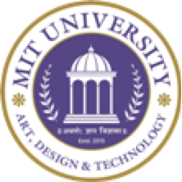
“BookIQ”
Project Presentation
Scanning and Searching Books for Credibility Score & References.
MITU22BTCS0104:- Amit Nishankar
MITU22BTCS0467:- Naman Babbar
MITU22BTCS0303:- Goutam Kumar
MITU22BTCS0303:- Khwaish Agarwal
Guided by
Prof. Umesh Nanavare
Department of Computer Science & Engineering, MITSoC, Loni Kalbhor

Slide 2
Outline
Introduction
Problem Statement
Objectives
Concepts & Methods
Literature Review
Identification of gaps & scope of work
Implementation
Reference
Q&A
Department of Computer Science & Engineering, MITSoE, Loni Kalbhor

Slide 3
Introduction
Students face difficulty verifying the credibility of learning materials.
Our platform allows user to scan or search books to get credibility score and reliable reference instantly.
Supports all types of sources: printed, eBooks, research papers, etc.
Department of Computer Science & Engineering, MITSoE, Loni Kalbhor

Slide 4
Problem Statement
To solve the problem of evaluating textbook quality before purchase, ensuring students and educators make informed decisions based on reliable reviews, structured insights, and OCR-based data analysis.
Objectives
Allows users to scan a book’s cover or search by title
Provides a detailed credibility score
Displays key content summaries
Offers access to verified academic references
Supports printed books, eBooks, research papers, and reference documents
Helps users choose trustworthy study resources
Department of Computer Science & Engineering, MITSoE, Loni Kalbhor

Slide 5
4. Concepts and Methods
OCR Scanning: Extract title from book cover.
Search Engine: Fetch data via APIs.
Scoring System: Based on author, citations, publisher, user ratings.
Database: Store book info and credibility data.
Department of Computer Science & Engineering, MITSoE, Loni Kalbhor

Slide 6
5. Literature Survey
Sr. no | Literature Title | Author | Findings
1. | An Overview of the Tesseract OCR Engine | Ray Smith | Presented Tesseract as an open-source OCR engine enabling accurate text recognition from scanned documents.
2. | BERT: Pre-training of Deep Bidirectional Transformers for Language Understanding | Jacob Devlin, Ming-Wei, Chang, Kenton Lee, Kristina, Toutanova | Introduced BERT, a deep bidirectional transformer model that significantly improved performance in text understanding and retrieval tasks.
Department of Computer Science & Engineering, MITSoE, Loni Kalbhor

Slide 7
Sr. no | Literature Title | Author | Findings
3. | S2ORC: The Semantic Scholar Open Research Corpus | Kyle Lo, Lucy Lu Wang, Mark Neumann, Rodney, Kinney Daniel S. Weld | Introduced S2ORC, a large, open-access corpus enabling scalable reference extraction and citation linking for scientific research
Department of Computer Science & Engineering, MITSoE, Loni Kalbhor

Slide 8
6. Tools and Languages
Frontend: HTML, CSS, Javascript,React.js
Backend: Node.js
OCR Tool: Tesseract OCR / Google Vision API
APIs: Google Books API.
Database: MongoDB
Other Tools: Postman (API testing), GitHub (version control), Figma (UI design)
Department of Computer Science & Engineering, MITSoE, Loni Kalbhor

Slide 9
7. Identification of gaps & scope of work
Gaps Identified:
Lack of unified credibility assessment for books from all formats.
No existing platform offers book scanning + citation credibility.
Users need multiple apps/websites for reviews, citations, and summaries.
Scope:
Develop an all-in-one platform.
Support for both online and offline materials.
Use machine learning to continuously improve credibility analysis.
Future integration with institutional libraries and LMS systems.
Department of Computer Science & Engineering, MITSoE, Loni Kalbhor

Slide 10
8. Implementation
Front-End:
Web interface with scanning and search features.
User-friendly dashboards showing scores, references, and highlights.
Back-End:
Data collection from Google Books API.
Node.js for processing and scoring algorithms.
MongoDB for storage and data indexing.
OCR Toolkits:
Tesseract or Google Vision API for extracting title from book cover scans.
Department of Computer Science & Engineering, MITSoE, Loni Kalbhor

Slide 11
AI Integration:
NLP models to summarize books and analyze context.
Scoring Engine:
Custom algorithm combining:
Number of academic citations
Publisher tier level
Peer reviews
User rating history
Department of Computer Science & Engineering, MITSoE, Loni Kalbhor

Slide 12
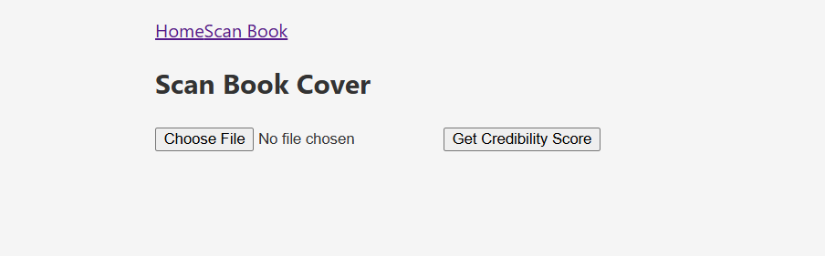
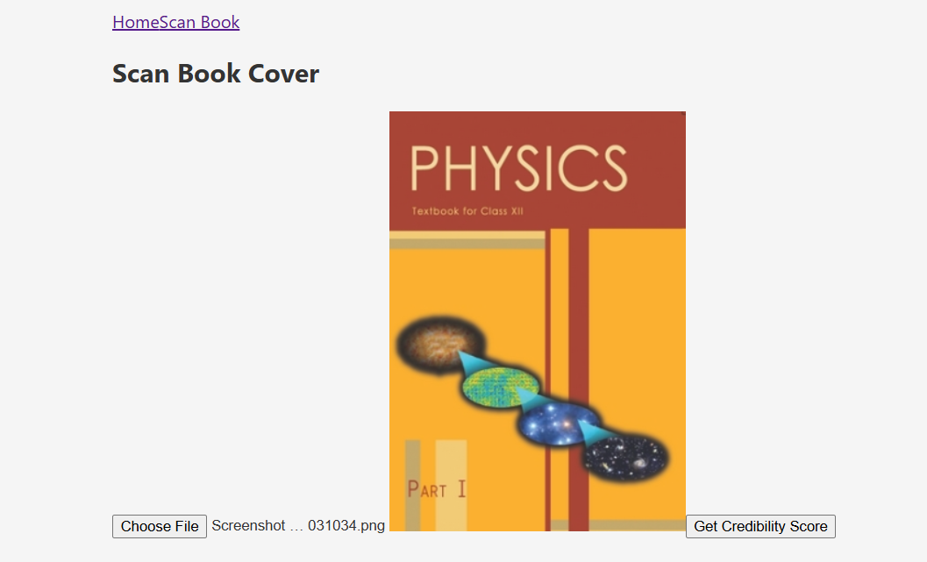
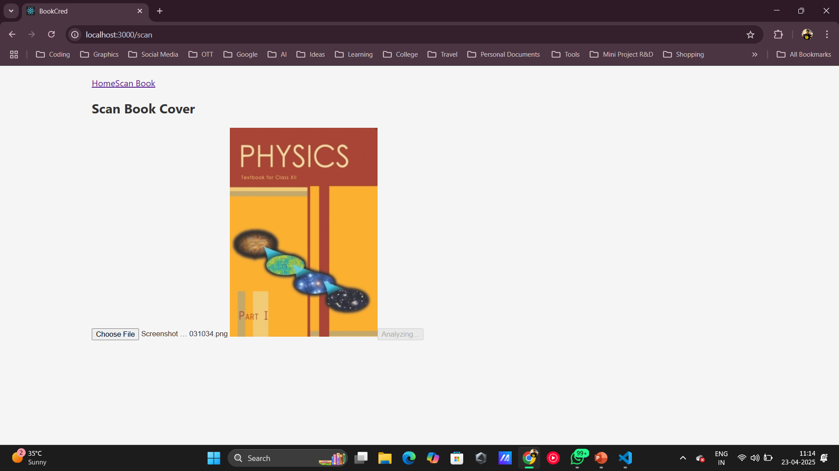
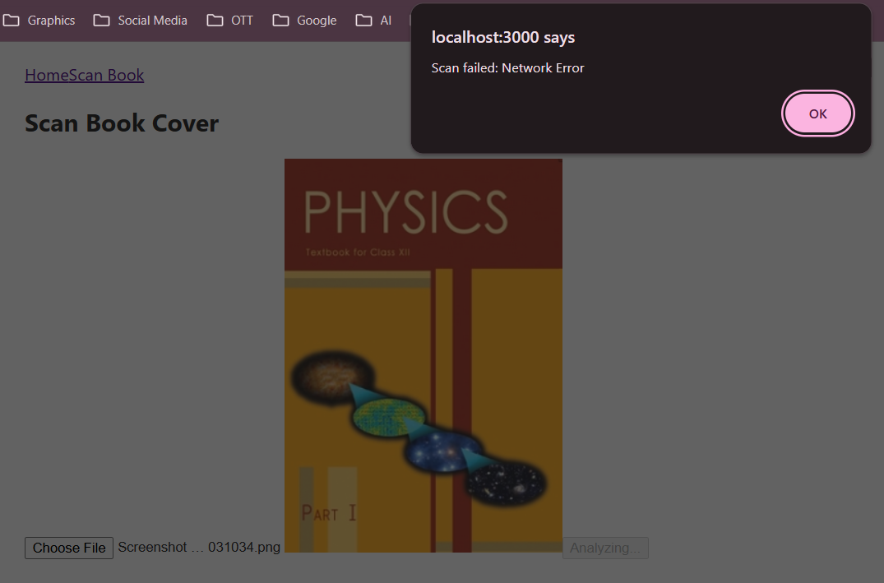
9. Results
We are currently in the process of making further advancements.
Attached are snapshots of the project phases that have been finalized.
Home Page
File Selected
Analyzing
Scan Failed
Department of Computer Science & Engineering, MITSoE, Loni Kalbhor

Slide 13
10. Conclusion and Future Work
Conclusion:
The system helps users quickly check a book’s credibility and references, making study material selection easier and more reliable.
Future Work:
Add regional/language support
Improve content summaries with AI
Link with university libraries
Launch a mobile app
Allow user reviews and ratings
Department of Computer Science & Engineering, MITSoE, Loni Kalbhor

Slide 14
11. References
[1] Smith, R. (2007). An overview of the Tesseract OCR engine. In Proceedings of the Ninth International Conference on Document Analysis and Recognition (Vol. 2, pp. 629–633). IEEE. Google Books API.
[2] Devlin, J., Chang, M.-W., Lee, K., & Toutanova, K. (2018). BERT: Pre-training of deep bidirectional transformers for language understanding. arXiv preprint arXiv:1810.04805.
[3] Lo, K., Wang, L. L., Neumann, M., Kinney, R., & Weld, D. S. (2020). S2ORC: The Semantic Scholar Open Research Corpus. In Proceedings of ACL (pp. 4969–4983).
Department of Computer Science & Engineering, MITSoE, Loni Kalbhor

Slide 15

Thank You
Department of Computer Science & Engineering, MITSoE, Loni Kalbhor

Slide 16

Questions
Department of Computer Science & Engineering, MITSoE, Loni Kalbhor

